Slide 1
Chapter 4
Jainism

Slide 2
Learning Objectives
4.1 Explain the Jain belief about the Tirthankaras.
4.2 Define the principles of nonviolence, nonattachment, and nonabsolutism.
4.3 Describe the key Jain spiritual practices.
4.4 Summarize the Jain diaspora.

Slide 3
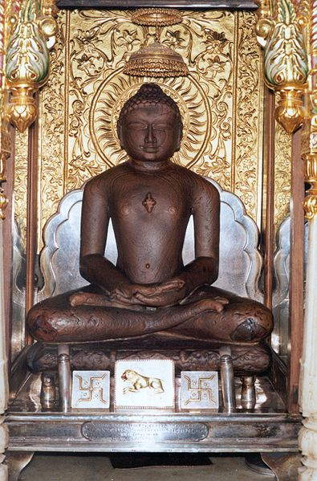
Ahimsa
This is a statue of a Jina in a temple
“One should not injure, subjugate, enslave, torture or kill any animal, living being, organism or sentient being.”
The Acaranga Sutra
Notes:
Shri 1008 Mahavir Swami
Source
Own work by uploader
Date
05/06/2001
Author
Dayodaya
Permission
(Reusing this image)
See below.
[edit] Licensing:
I, the copyright holder of this work, hereby publish it under the following licenses:
Creative Commons license
Creative Commons Attribution Creative Commons Share Alike This file is licensed under the Creative Commons Attribution ShareAlike 3.0 License. In short: you are free to share and make derivative works of the file under the conditions that you appropriately attribute it, and that you distribute it only under a license identical to this one.

Slide 4
“The practice is that you have to look upon worldly things as the seer. You are not to be involved in them, because through attachment with worldly things you land up with those problems that are existing in the world. If you detach yourself, you become only a seer, and then you attach yourself with the self only.”
M. P. Jain
Notes:
M. P. Jain, interviewed March 2009.

Slide 5
Freeing the soul: the ethical pillars
What are the basic principles Jains adopt to avoid accumulating karma?
jiva: individual’s higher consciousness, or soul
ajiva: non-sentient matter; karmic particles that adhere to the jiva
samsara: the wheel of birth and death
Jina: “winner,” one who has conquered passions

Slide 6
Triratna “Three Jewels”
Samyak Darshan – right belief or faith
fully accepting the Jain concept of the universe and reality
Samyak Jnana – right knowledge
Literally 'correct knowledge', it means grasping properly the fundamental truths in its details.
Samyak Charitra – right conduct
right ethics and practice for laypeople and monks and nuns

Slide 7

Jain Community (Tirtha)
Fourfold
Monks – sadhus
Nuns – sadhvis
Laymen – support the monks & nuns
Laywomen – support the monks & nuns
The comprehensive Jain symbol consists of a crescent of the moon, three dots, the Swastika or Om, the palm of a hand with the wheel (Chakra) inset, and an outline figure encompassing all symbols. Each individual symbol is also separately used in Jainism.
Notes:
The outline of the image represents the universe
Swastika
Heavenly beings ("devas encantadia")
Human beings
Hellish beings
Tiryancha (subhuman like flora or fauna)
The upper portion indicates heaven, the middle portion indicates the material world and the lower portion indicates hell.
The semi-circular topmost portion symbolizes siddhashila, which is a zone beyond the three realms. All of the siddhas or liberated bodiless souls reside on this forever, liberated from the cycle of life and death. The three dots on the top under the semi-circle symbolize the Ratnatraya – right belief, right knowledge, and right conduct.
"All life is bound together by mutual support and interdependence."

Slide 8
Non-violence
Ahimsā paramo dharmaḥ
“Non-violence is the highest religious duty.”
All souls are like oneself in that they suffer distress, cling to life, and do not wish to be destroyed
Qualities – friendship, goodwill and peace through gentleness and lack of passion
Notes:
Ascetic cannot light fires, dig or plough the ground, must drink filtered or boiled water, inspect his surrounding carefully to avoid injury and avoid exaggerated movement of the body
Karma generated in the performance of religious duties disapperas instatenously
Supererogatory potatoes, onions, and garlic

Slide 9
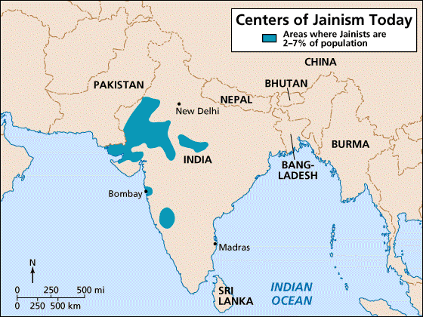
To the left is a map of Centers of Jainism today in South Asia

Slide 10
Introduction
While the majority of religious Indians continue to follow Hindu paths, Jainism is also a religion native to Mother India.
Chapter 4 explores this non-Vedic tradition with the following goals: to describe Jainism and its distinctiveness from Hinduism and to explain three major animating principles of Jain belief: ahimsa, aparigraha, and anekantwad.

Slide 11
Karma
kevala:
highest state of perfection
Knowledge of ‘solitariness’ = moksha
Three principles to avoid karma:
nonviolence (ahimsa)
nonattachment (aparigraha)
nonabsolution (anekantwad)

Slide 12
Introduction
Jainism has approximately 4.5 million adherents and is not based on the Vedas.
Hinduism and Buddhism has been influenced by Jainism.
Through the recognition of human imperfection, Jains believe that each person can attain perfection, freedom, and happiness through careful control of his or her senses.
The focus on nonviolence and ecological wisdom is an enormous contribution to global culture.

Slide 13
Jainism
Extreme asceticism leads to enlightenment
ascetic – austere, detached from worldly comforts
Influence and interaction with Hinduism & Buddhism

Slide 14
The Tirthankaras and ascetic orders (1 of 2)
Who are the Tirthankaras?
Mahavira (The Great Hero)
527 BCE
Contemporary of the Buddha
Kshatriya: royal or noble caste of warriors & leaders
Tirthankaras: “Fordmakers” who steer people to religion for they create a crossing or “ford” across the river of rebirth to the further shore of liberation.
23 Tirthankaras before Mahavira

Slide 15
4.1 The Tirthankaras and ascetic orders
Mahavira, “The Great Hero,” is Jainism’s major teacher
Historical founder - Vardhamāna Mahāvira (599-527 B.C.E)
A contemporary of the Buddha (and like the Buddha, a prince of the Kshatriya clan who renounced his position and wealth) in the sixth century BCE.
Mahavira is the twenty-fourth of the Tirthankaras, or “Fordmakers,” considered by Jains to be great teachers.

Slide 16
4.1 The Tirthankaras and ascetic orders
Hindu and Buddhist texts refer to Jainism as a tradition that began long before Mahavira. Jainism, a non-Vedic Indian tradition, does not officially acknowledge the caste system.
As an ascetic path, Jainism is practiced in its fullest by monks and nuns.
Some of the extremes to which adherents will carry the principle of nonviolence include wearing a gauze mask over the face to avoid inhaling insects and other organisms.

Slide 17
4.1 The Tirthankaras and ascetic orders
Such practices make vivid and unforgettable examples of the wide variety of religious practices found in the world’s religions.
Jain nuns and monks are celibate. They fast, do penance, and learn to endure hardships with indifference.
The text points out that one sect, the Digambaras, wear no clothes to demonstrate their innocence and their lack of attachment to material goods (even clothing).

Slide 18
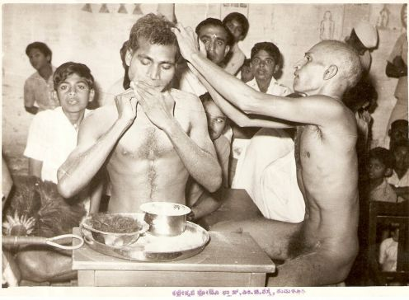
Digambaras
A Jain Digambaras monk undergoing ordination while ripping out the hair of his and beard. He is helped by another monk.
Monk undergoing ordination while ripping out the hair of his head and beard

Slide 19
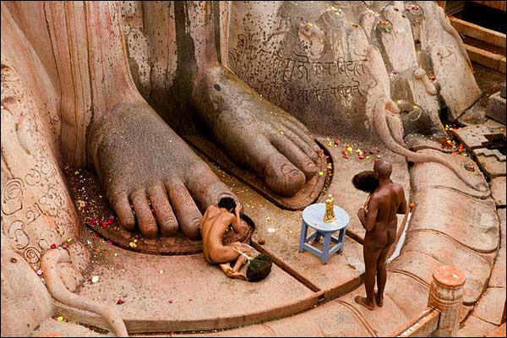
Two main divisions Digambaras or ‘sky-clad’ – monks only
Only possessions:
small whisk of peacock feathers
water pot for cleaning themselves
Ascetic nudity as necessary for the attainment of liberation
Women cannot achieve liberation
A picture of 2 Jain
Digambaras or ‘sky-clad’ monks worshiping a
large stature of a Jina
Notes:
Split occurs @ 4th or 5th centuries

Slide 20
4.1 The Tirthankaras and ascetic orders
The Shvetambaras, by way of contrast, believe that wearing white robes is an acceptable practice that does not interfere with one’s personal purification.
While the Digambaras maintain that one must be born a male to attain liberation, the Shvetambaras believe that both males and females are capable of it, and this branch of Jainism supports a substantial order of nuns.

Slide 21
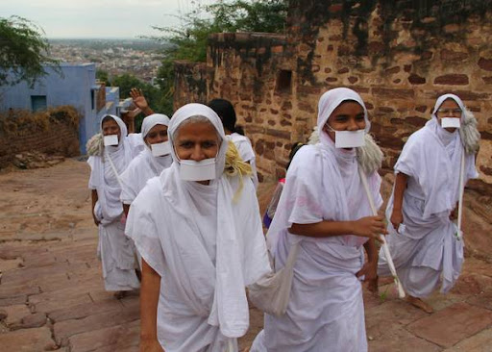
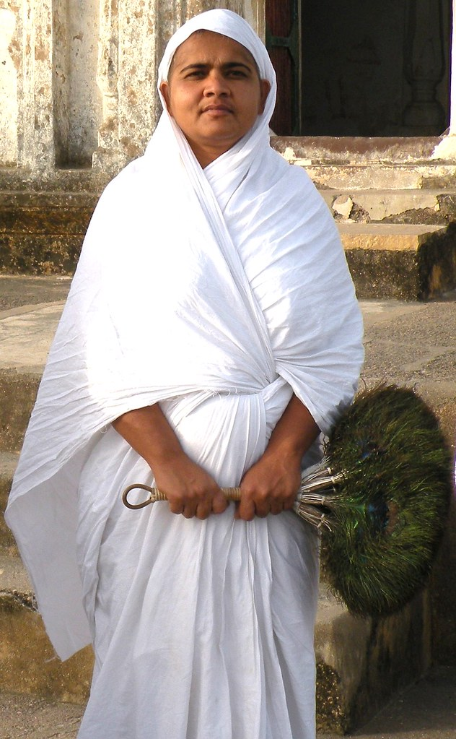
Śvetāmbaras nuns and a Digambara nun
Pictures of
Śvetāmbaras nuns and a Digambara nun. The Digambara nuns wear masks

Slide 22
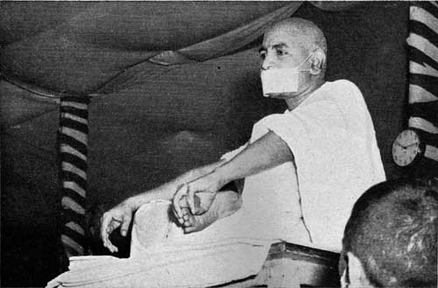
Śvetāmbaras (Shvetambaras) or ‘white-clad’ – monks and nuns
Possessions:
Three pieces of cloth to wear
a whisk made of wool
a begging-bowl
a staff
Women can achieve liberation
One of the tirthankaras was a woman
A Śvetāmbaras monk

Slide 23
4.2 Freeing the soul: the ethical pillars
Jainism expresses belief in jiva, the individual’s higher consciousness or soul, which has the capacity to save itself.
Like Hinduism, Jainism maintains belief in samsara, the cycle of death and rebirth (reincarnation) until liberation is achieved.
One who attains the highest purity in their being is called Jina (“winner”), the word from which the term Jain is derived..

Slide 24
4.2 Karma
Jains believe that the universe is without beginning and that there is no divine creator or destroyer. Our own actions can save us.
While Jainism shares the concept of karma with both Hinduism and Buddhism, the Jain understanding of karma is unique insofar as karma is considered to be subtle matter that accumulates and clings to us as we think and act.

Slide 25
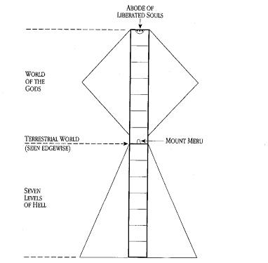
Jain Cosmos
Notes:
The outline of the image represents the universe
Swastika
Heavenly beings ("devas encantadia")
Human beings
Hellish beings
Tiryancha (subhuman like flora or fauna)
The upper portion indicates heaven, the middle portion indicates the material world and the lower portion indicates hell.
The semi-circular topmost portion symbolizes siddhashila, which is a zone beyond the three realms. All of the siddhas or liberated bodiless souls reside on this forever, liberated from the cycle of life and death. The three dots on the top under the semi-circle symbolize the Ratnatraya – right belief, right knowledge, and right conduct.
"All life is bound together by mutual support and interdependence."
Hasten the decay of karma that has already obscured the jiva
Freed from rebirth, able to rise to the upper reaches of the universe:
eternally dwell there in its innate perfection: total knowledge and self-containment
Jainism differs from Buddhism in that it holds that the soul, when finally emancipated, reaches a heaven and there continues for ever a separate intellectual existence, and is not absorbed into Nirvāna or a state of blessed nothingness.

Slide 26
Jain Cosmos
Two pictures of the Jain cosmos
Notes:
The outline of the image represents the universe
Swastika
Heavenly beings ("devas encantadia")
Human beings
Hellish beings
Tiryancha (subhuman like flora or fauna)
The upper portion indicates heaven, the middle portion indicates the material world and the lower portion indicates hell.
The semi-circular topmost portion symbolizes siddhashila, which is a zone beyond the three realms. All of the siddhas or liberated bodiless souls reside on this forever, liberated from the cycle of life and death. The three dots on the top under the semi-circle symbolize the Ratnatraya – right belief, right knowledge, and right conduct.
"All life is bound together by mutual support and interdependence."
Hasten the decay of karma that has already obscured the jiva
Freed from rebirth, able to rise to the upper reaches of the universe:
eternally dwell there in its innate perfection: total knowledge and self-containment
Jainism differs from Buddhism in that it holds that the soul, when finally emancipated, reaches a heaven and there continues for ever a separate intellectual existence, and is not absorbed into Nirvāna or a state of blessed nothingness.

Slide 27
4.2 Karma
Jains distinguish between destructive and nondestructive types of karma but believe that all karma must be eliminated to attain the highest state of perfection that is known as kevala.
Jains adopt three basic principles to avoid accumulating karma: ahimsa, aparigraha, and anekantwad.

Slide 28
4.2 Ahimsa
According to the Jain understanding of ahimsa, or nonviolence, all life in all forms is valuable and therefore should not be destroyed or injured.
Recognized as a virtually impossible ideal for humans, ahimsa also teaches that although human life is inevitably destructive, its ultimate aim is to cause as little harm as possible to other creatures, including other persons.
Jains are strict vegetarians.

Slide 29
4.2 Ahimsa
Ahimsa extends to thinking and speaking as well because abusive words and negative thoughts can harm others.
Many occupations are frowned on by Jains because of the harm they cause other creatures.
For example, becoming a butcher would involve causing the death of many innocent animals.
Jains believe the killing of these creatures brings much karma on the worker.

Slide 30
4.2 Ahimsa
Even agriculture causes harm to insects and organisms.
Many Jains thus take up occupations that they consider harmless, such as banking, education, law, or publishing.

Slide 31
4.2 Aparigraha
Aparigraha, or nonattachment to both things and people, is a central Jain idea, the cultivation of which kindles the way to inner peace.
It is notable that Jainism teaches that this non-acquisitiveness is not only the way to inner liberation but is also valuable for the world as well.
Jainism teaches that if more people limit their needs and desires, then fewer demands will be placed on the environment.

Slide 32
4.2 Anekantwad
Anekantwad means “manifold aspects” and has a nonabsolutist perspective.
Jains believe that it is important to resist anger, to remain open-minded and to avoid judgmentalism.
In other words, Jains must be sensitive to the truth that the issues can be seen from many different angles.
Because truth has many facets, the enlightened person is responsive to the subtleties of existence.

Slide 33
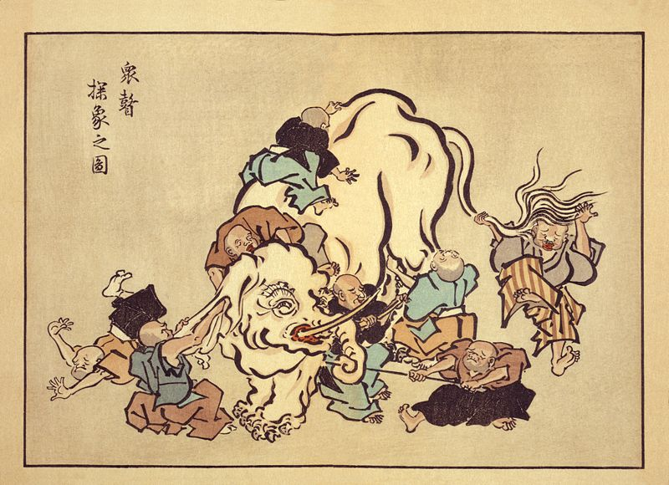
The Parable of the Blind Men and the Elephant
An image of blind men
Touching different parts of
an elephant and arguing
Over what the parts of the elephant are.
Notes:
They tell the story of the blind people who are asked to describe an elephant.
The one who feels the trunk says an elephant is like a tree branch.
The one grasping a leg argues that an elephant is like a pillar.
The one feeling the ear asserts that an elephant is like a fan.
The one grasping the tail insists that an elephant is like a rope.
And the one who encounters the side of the elephant argues that the others are wrong; an elephant is like a wall.
Each has a partial grasp of the truth.

Slide 34
4.3 Spiritual practices
Jainism is an ascetic path.
Jain monks and nuns are celibate, practice physical penance and fasting, and have few possessions.
Sometimes they carry their asceticism to extremes (for example, eschewing bathing in the interest of not harming water-bodies or refusing to fan themselves in the interest of not disturbing creatures in the air).

Slide 35
4.3 Spiritual practices
Jain laypeople, too, seek to lead simple lives.
Jain homes are kept very clean, and Jains are strict vegetarians.
There are twelve “limited” vows Jain laypeople are to undertake, the first five being the most important: nonviolence, truthfulness, not taking anything that has not been given, renouncing any sexual activity outside marriage, and limiting one’s possessions.
Many Jains in India are very successful in their professions and follow the dictate of nonpossessiveness through philanthropy.

Slide 36
4.3 Spiritual practices
Lay Jains are divided into those who worship at temples and those who do not.
The temples contain images of the Tirthankaras, all of which look alike because the perfect soul is nonparticularized.
The Tirthankaras are seen not so much as helpers but as role models.
There is no concept of divine intervention and thus there is not a great emphasis on priesthood, so laypeople may carry out their own worship services.
The ultimate spiritual practice for Jains is fasting unto death at the end of their lives.

Slide 37
4.3 Spiritual practices
The ultimate spiritual practice is the now-controversial fasting unto death at the end of a life, a discipline that requires many years of previous ascetic practice and other that may be only be undertaken because of very old age, terminal illness, famine, or dire calamity.

Slide 38
4.3 Festivals and pilgrimages
Jain holy days are typically celebrated with meditation, renunciation, fasting, scriptural study, and hymns.
Like Hindus, Jains celebrate Divali, but Jains celebrate with a three-day fast and an entire night reciting hymns and meditating on Mahavir. A subsequent day may include cleaning and worshiping books in religious libraries.
(Religious Studies term for this is bibliolatry)

Slide 39
4.3 Festivals and pilgrimages
The most important Jain festival is Paryushan Mahaparva, an annual festival of atonement. Many Jains begin their celebration with an eight-day fast, followed by a final Forgiveness Day when people seek forgiveness from those toward whom they feel hatred and try to cultivate compassion.
Individuals, families, and groups may also go on pilgrimages to sacred sites, many of which are located in the state of Bihar.

Slide 40
4.4 World Jainism
For most of its history, Jainism survived as a minority religion within India; since the twentieth century, it has been carried outside India by several teachers.
Jains still have an attachment to India.
Extreme asceticism is no longer practiced in favor of environmentalism, animal rights, nonviolence, and interfaith activities.

Slide 41
4.4 World Jainism
One such teacher, Acharya Tulsi, initiated new orders of semi- monks and nuns.
He also started the Anuvrat (“small vow”) Movement to encourage people of all faiths to cultivate strong moral standards.

